Slide 1
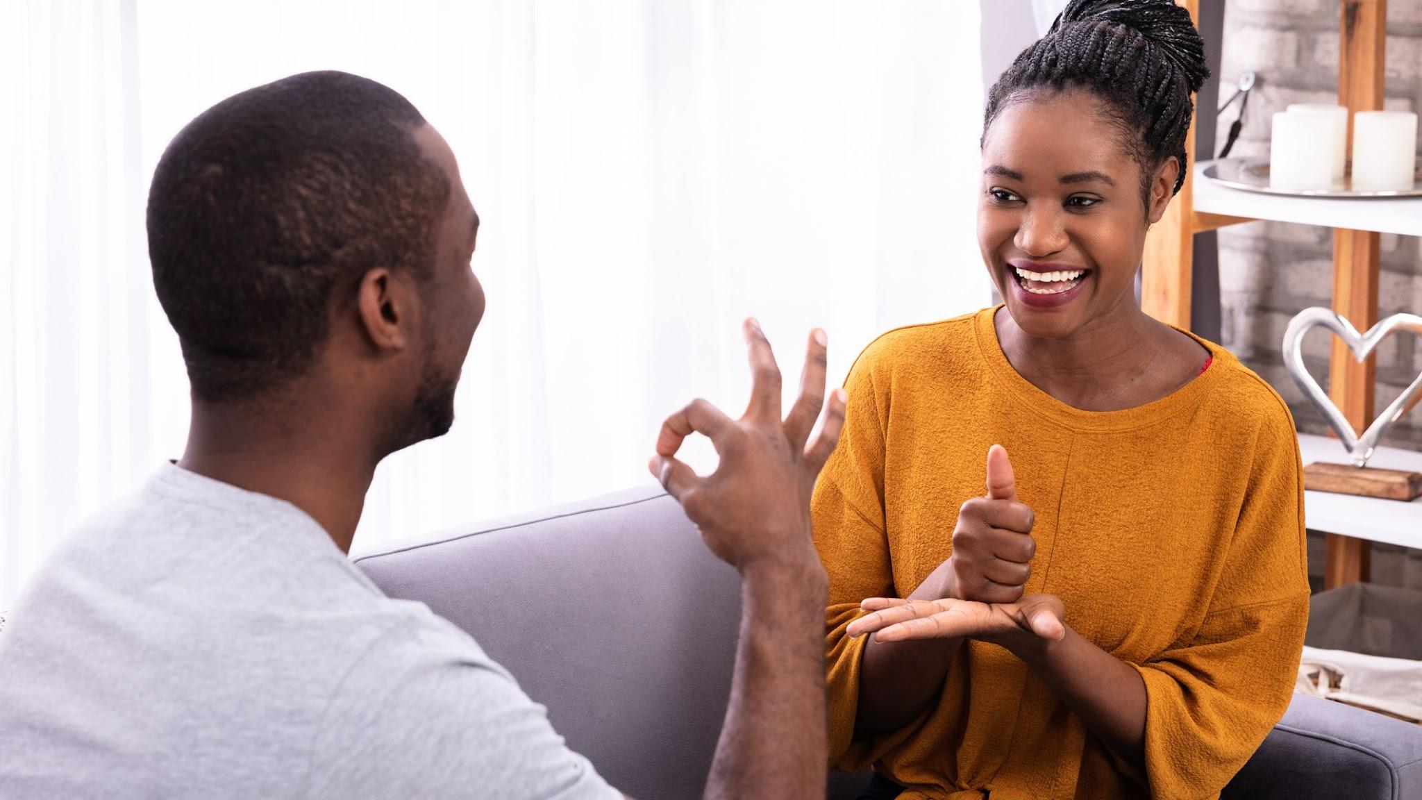
American Sign Language Alphabet Image Classification
Team 5 | Predictive Modelling Report
Beard, Bennion, Carlson, Napolitano

Slide 2
The Proble
4,600,000 million Americans report having disabling hearing loss
Only 500,000 Americans use ASL
2
1
Those with hearing disabilities have an extreme communication disadvantage
U.S. Department of Health and Human Services. (n.d.). Quick statistics about hearing. National Institute of Deafness and Other Communication Disorders. Retrieved May 5, 2022, from https://www.nidcd.nih.gov/health/statistics/quick-statistics-hearing
2. Mitchell, Ross; Young, Travas; Bachleda, Bellamie; Karchmer, Michael (2006). "How Many People Use ASL in the United States?: Why Estimates Need Updating" (PDF). Sign Language Studies. 6 (3). ISSN 0302-1475. Retrieved November 27, 2012.

Slide 3
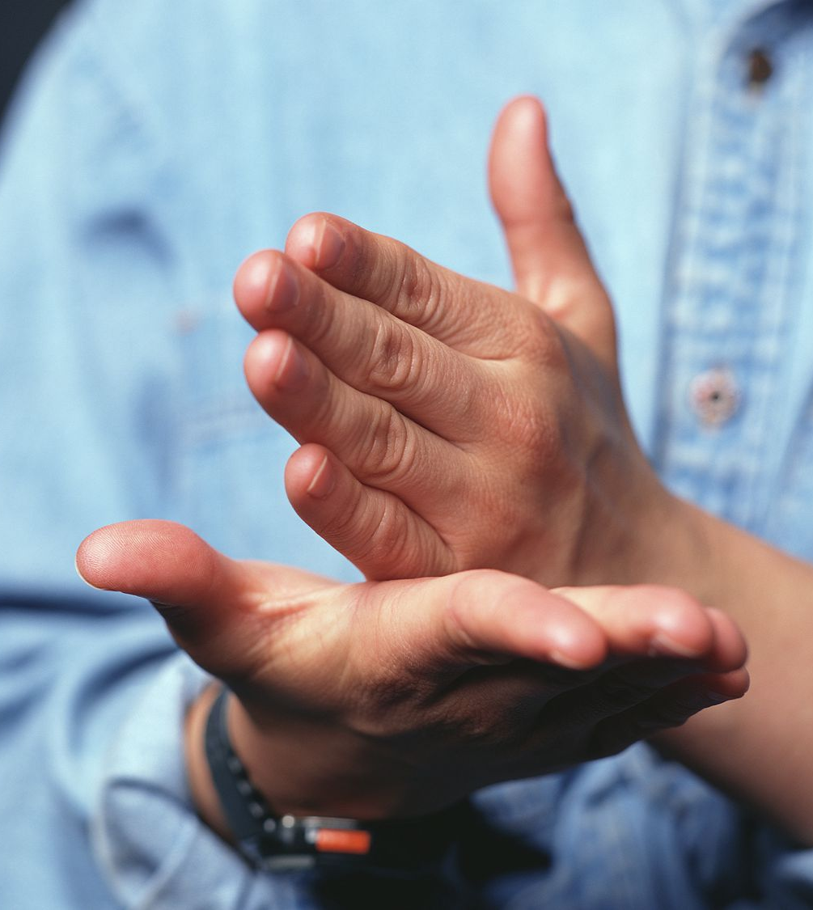
The Solution
Using Computer Vision
To Serve Those Hard of Hearing

Slide 4
Recap
1 | Compile an Accurate ASL Alphabet Data Set | Complete
1.1 | Record Raw Video Footage of ASL Alphabet Signs | Complete
2 | Preprocess Data Set To Prepare for Modelling | Complete
2.1 | Split Video Into Still Frames | Complete
2.2 | Normalize Color | Complete
2.3 | Normalize Size | Complete
2.4 | Normalize Resolution | Complete
2.5 | Produce Image Vector CSVs | Complete
3 | Exploratory Data Analysis | Complete
3.1 | Image Class Balance Analysis | Complete
3.2 | Analysis of the Basic Metrics of Variables | Complete
3.3 | Non-Graphical and Graphical Univariate Analysis | Complete
3.4 | Feature Engineering and Analysis | Complete
4 | Develop an ML model capable of learning ASL alphabet | In Progress
4.1 | Model I: KNN | In Progress
4.2 | Model II: CNN | In Progress
4.3 | Model III: CNN with Transfer Learning | In Progress

Slide 5
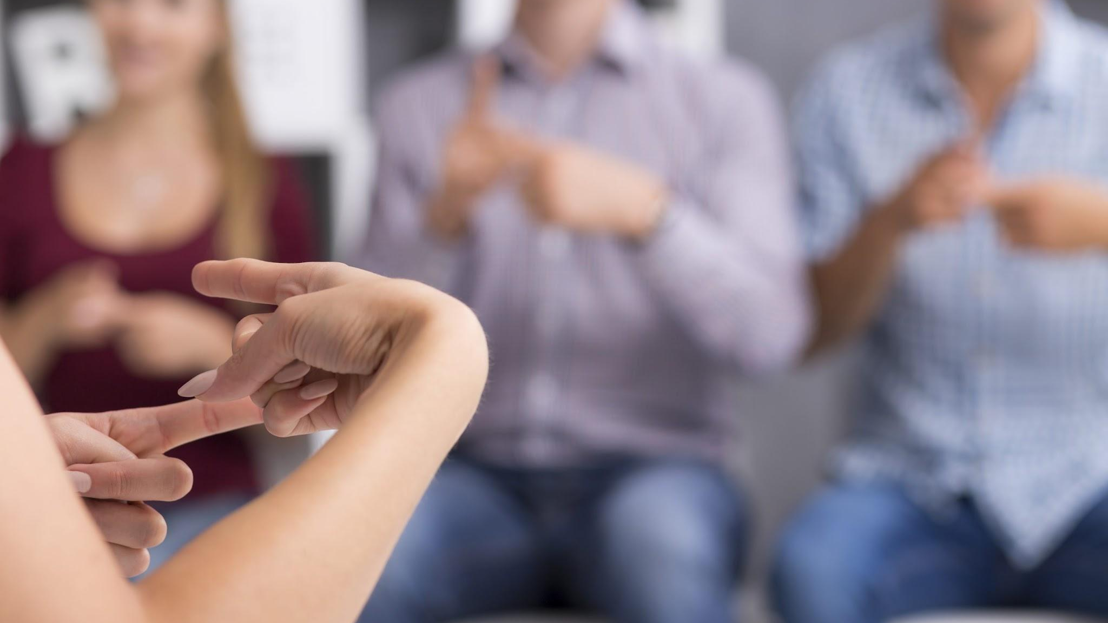
Dataset & EDA Summary
Notes:
zach

Slide 6
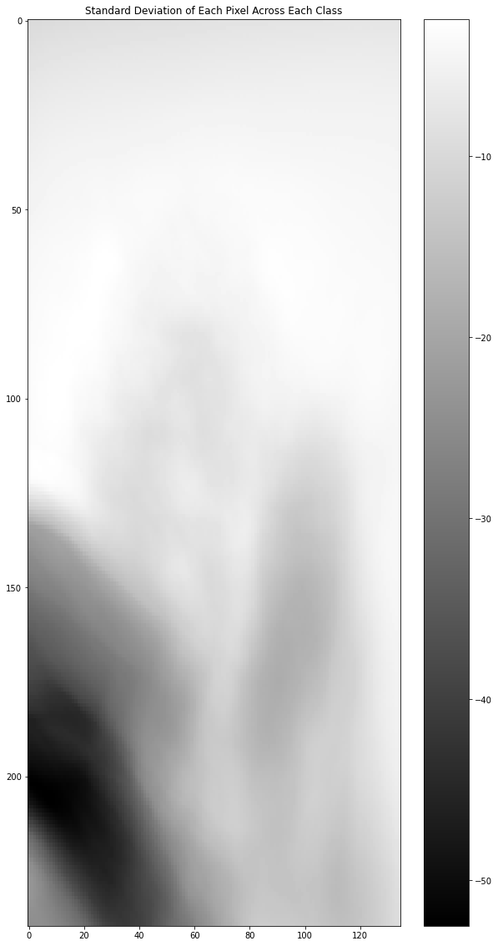
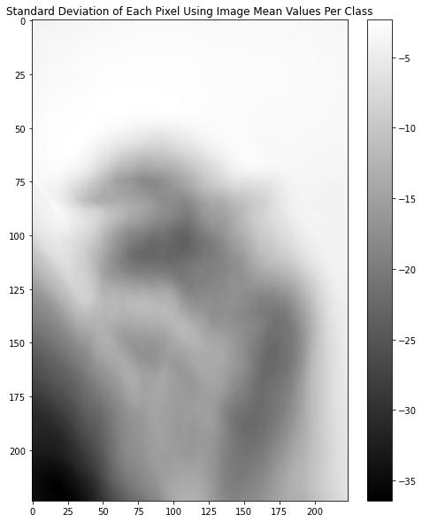
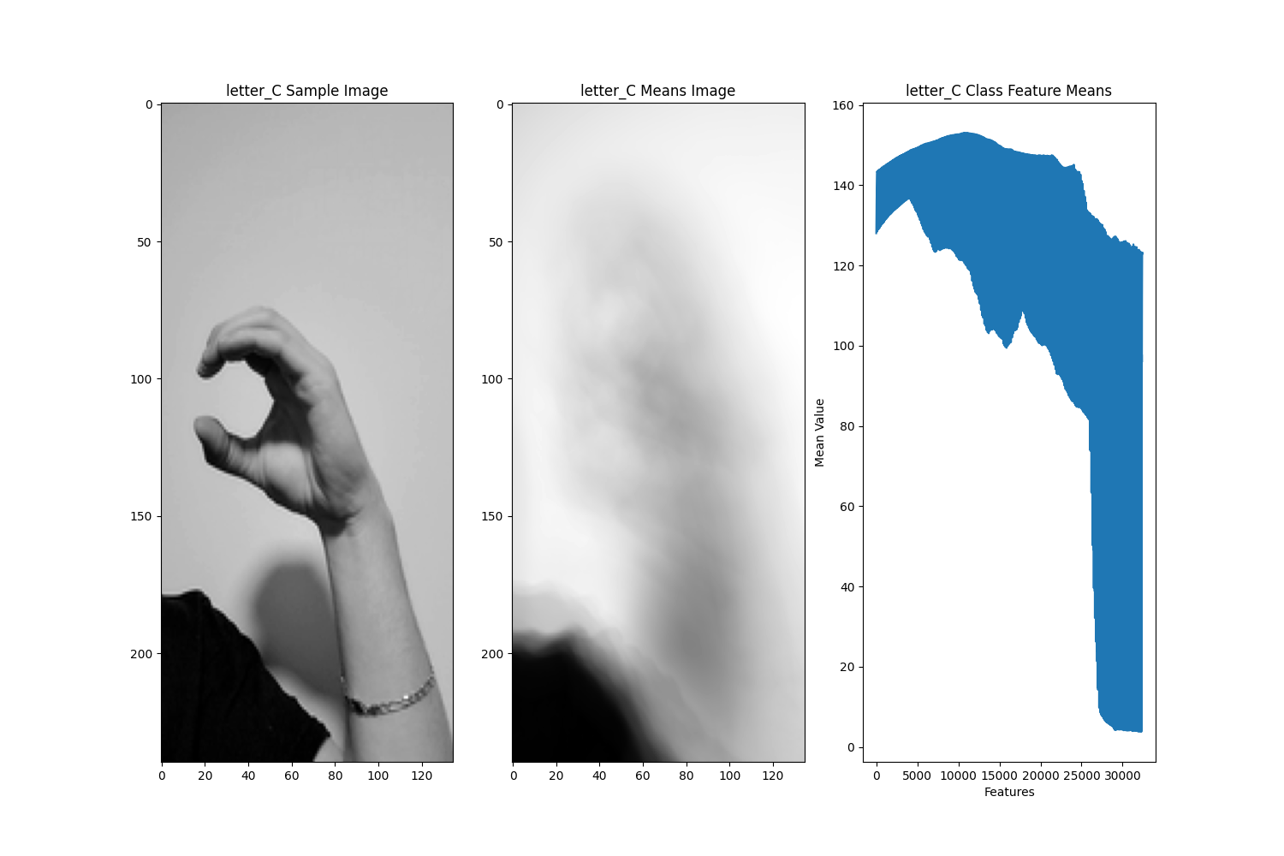
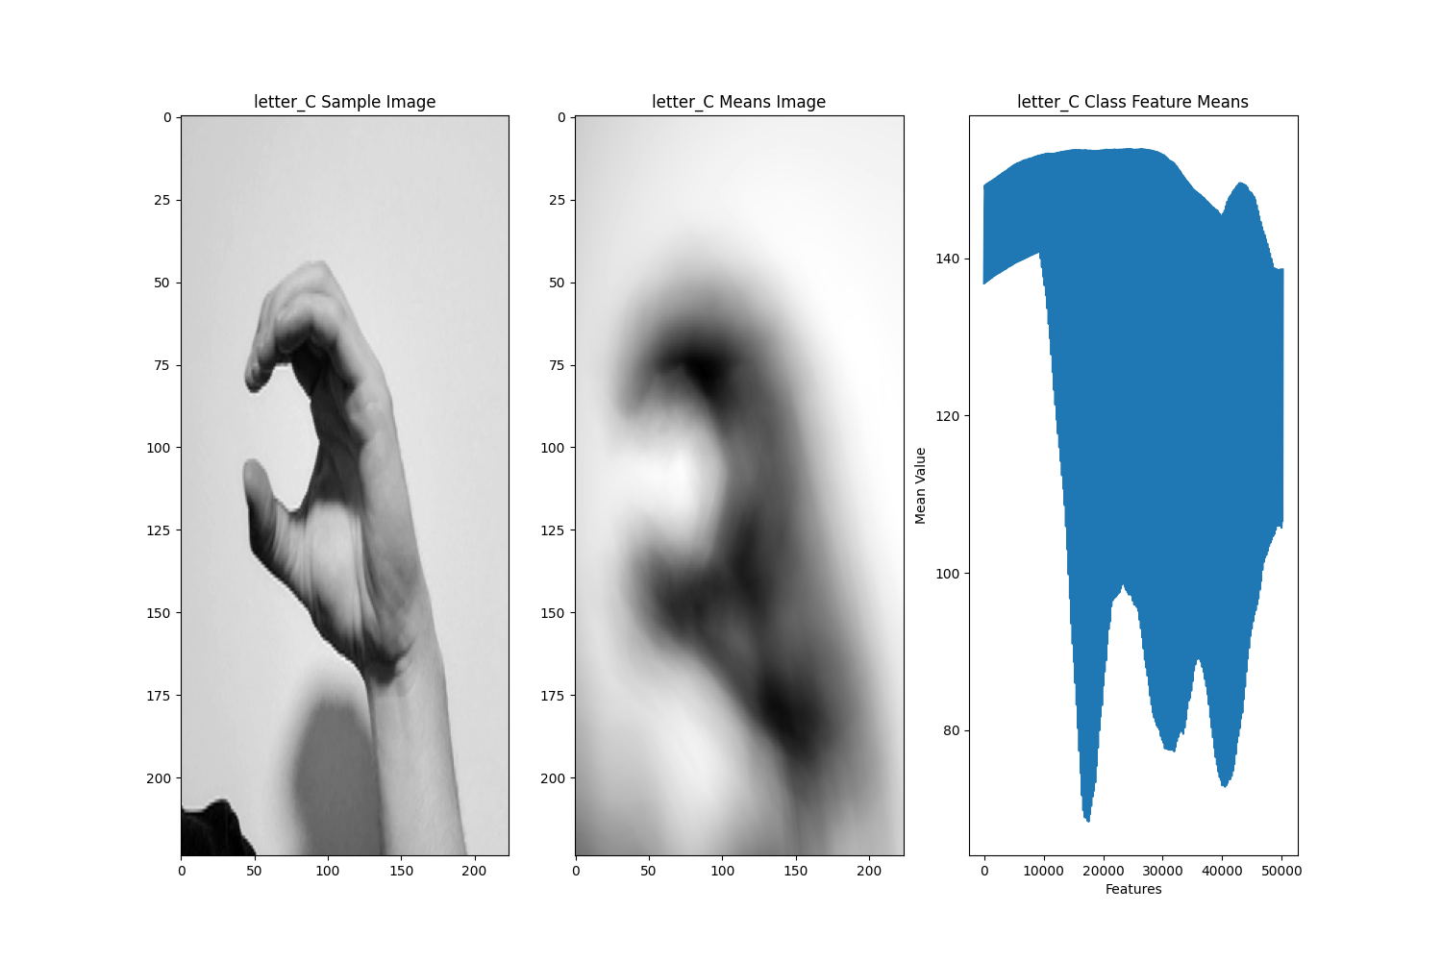
Reintroducing the Dataset
Before
After
24 classes with about 930 image samples each with refined preprocessing approach to minimize the amount of unnecessary pixels in our training images.
Improvements:
Shrink original 1080p images to 224x398
Add y axis centering
Crop images to 224x224
Reapply grayscaling
Result:
Images with more focus on operative subject (hand) and greatly reduced proportion of unnecessary pixels
224x224 images converted to a vector of 50,176 integers representing the scaled, cropped, and centered image of a hand signing the ASL alphabet
The array of integers range in values between 0 and 255 correlating to the grayscale pixel value

Slide 7
Model I - KNN

Slide 8
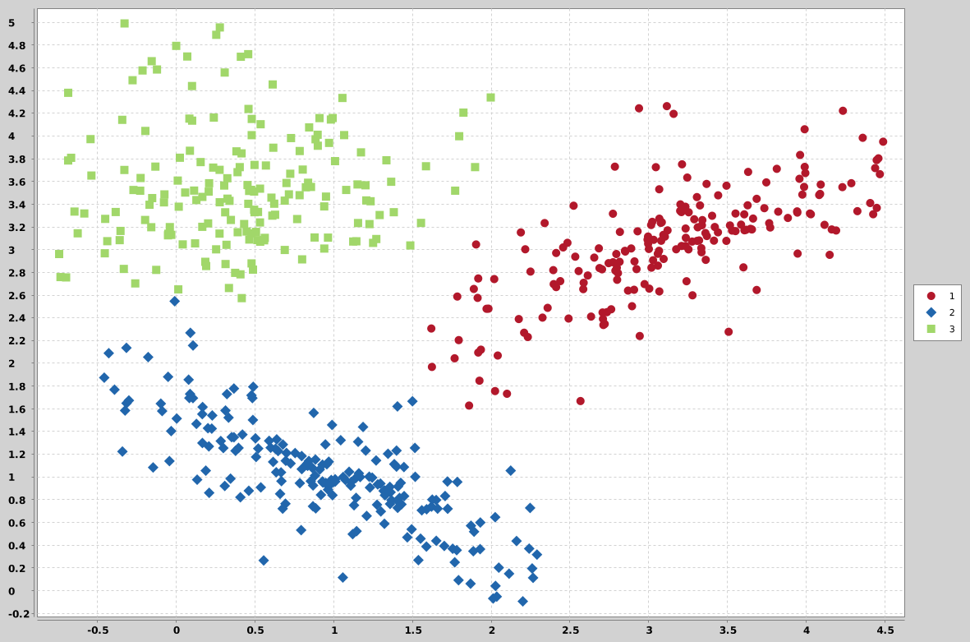
Model I - K Nearest Neighbors - Intro
Relies on the assumption that data points that are similar with each other will cluster with each other
Algorithm calculated uses a distance function to estimate the distance between a given point and its neighbors
Algorithm determines a label by evaluating the k neighbors and applying the most common label of that sample
For example, if k = 10, the algorithm will look at the ten nearest neighbors and apply the most common label of those 10 neighbors

Slide 9
Model I - K Nearest Neighbors - Justification
Tends to be one of the more simple algorithms to implement and understand
2 decision points: which distance function to use & what value of k to assign
Do not require training time (all processing time is realized at the moment of prediction)
Relatively strong ability to accommodate multiclass problems

Slide 10
Model I - K Nearest Neighbors - Dimension Reduction
Dimension reduction is ideal to avoid overfitting
Ideally fewer features than samples
PCA proved to be the easiest to implement
LDA would reduce to too low of a dimensionality
target number of dimensions was decided by keeping permitted error at 15% or less with the Johnson Lindenstrauss lemma...
15% was decided by balancing the resulting dimensions and the permitted error, since we only have a mean of 931 samples per class...
Original number of features: 50,176
Result: 3,936 components

Slide 11
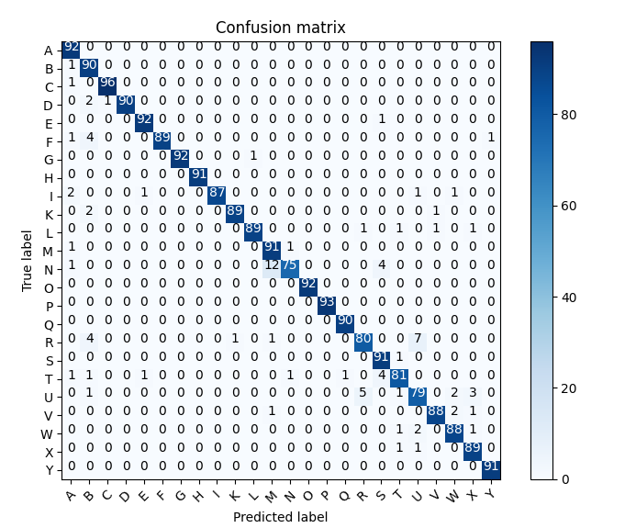
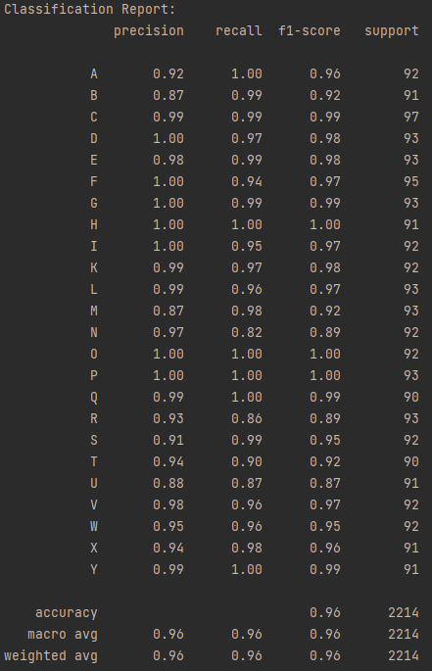
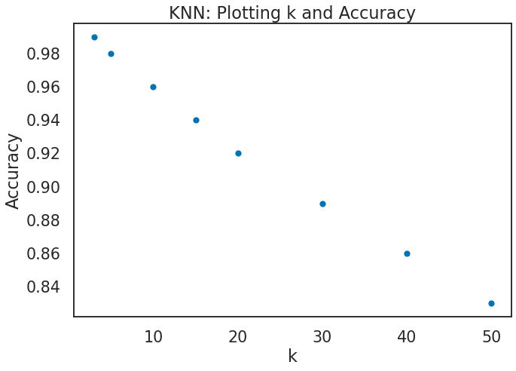
Model I - K Nearest Neighbors - Initial Attempts
Evaluating model performance based on accuracy
Precision and recall can be helpful at the class level but becomes complex to produce at the model-level when evaluating 24 classes
Diminishing accuracy returns were observed as we increased the k value from 3 up to 50
k=3 produced an accuracy score of 99% on the test population while k=50 produced just 85% accuracy

Slide 12
Model I - K Nearest Neighbors - Areas for Improvement
Dataset is extremely uniform - opportunity to introduce variation during preprocessing
Experimentation with different distance functions
Further development of better dimensionality reduction methods

Slide 13
Upcoming Model Development

Slide 14

Model II - Convolutional Neural Network (CNN)
Model II - Convolutional Neural Network (CNN)
With Transfer Learning
We plan on implementing a CNN with at least 2 Convolutional ReLu layers that will apply max pooling after each
We plan on experimenting with Kernel size at each layer using either 5x5 or 3x3 as well as the amount of padding
We plan on experimenting with the dropout rate as well
We have identified CNN weights that have been trained based on a 16-layer deep pre-trained CNN that achieved 97% accuracy for an ASL alphabet dataset
This will allow us to focus on the very last fully connected layers to try and achieve optimum accuracy
Notes:
The next models we are going to implement will be a Convolutional neural net and a CNN with transfer learning. The first implementation of our CNN we will do without any prior learning. We will play around with the kernel size, stride and padding for the convolutional layers trying to see what works best for extracting the low level features like edges and shapes and moving towards the high level features like identifying fingers and their placements. We will also include max pooling layers after each convolutional layer in order to reduce the noise and size of the features extracted from convolutional layers. For the activation function of each convolutional layer we have chosen to use ReLu which will help improve speed and accuracy of identifying which nodes should fire when given feature inputs. In our fully connected layers of the CNN, we will toy with the number of hidden layers, still use a ReLu activation function for each, play with a dropout layer to avoid overfitting, and use a softmax function to determine the probability the features represent 1 of the 24 classes.
Our second model will be a CNN with transfer learning. We have identified a good pre trained CNN that saw an accuracy of 97% on their test dataset, and we are looking to take that and try and improve the accuracy. Using the pre trained weights from there model we will freeze in place the convolutional and max pooling layers weights and modify the fully connected layers only. If time allows we may retrain some of the last layers of the convolutional and pooling stage.
We are hoping that these models prove even more accurate then our KNN and will be thinking about adding more varied data to our dataset.

